Slide 1
Immense Import Trade Value by Countries
By:
110590040 徐釧龍
110590044 黃家輝
110590069 黃程義

Slide 2
Introduction
Import Trade Values of Various Countries in Taiwan
Taiwan’s import trade
Trading Partners
Economic Trends
Impacts
Outsiders point of view
Understanding the value that could be appreciated by other countries
How could we take advantage of it

Slide 3
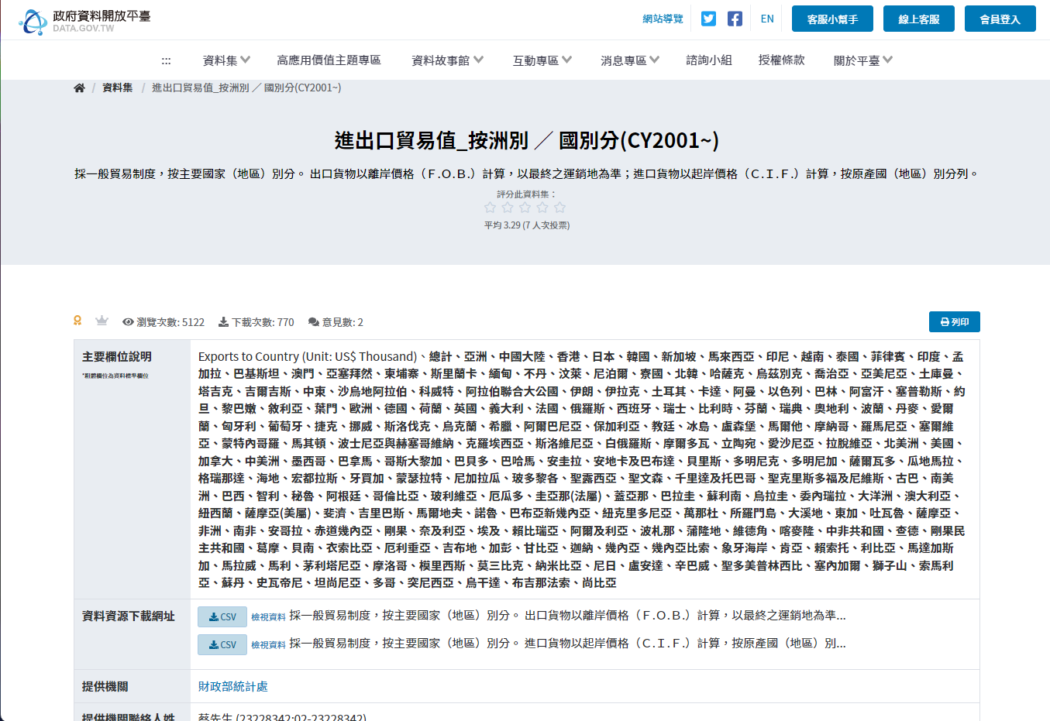

Slide 4
Table of contents
01
03
02
04
The All Mighty Chardet
Presenting the Top 10 Importers
A Universal Character Encoding Detector, a very useful encoding detector
Presenting the data we compiled by sorting out the 10 highest importers
Top 10 Highest Imports by Year
Continent Based Import Values
Presenting the data we compiled by sorting out the highest importing years
Finalizing the data through a bigger demographic view

Slide 5
01
The All Mighty Chardet
Our lord and savior, saved us in our time of need

Slide 6
The All Mighty Chardet
Chardet
ASCII
UTF-8
UTF-16
Many More
American Standard Code for Information Interchange
UCS (Unicode) Transformation Format in Binary Strings
Same thing but on 2 or 4 bytes
Disasters

Slide 7
Top 10 Highest Imports by Year
Import Trends
Import Preferences, Shifts in composition, overall growth/decline of industries
Market opportunities
When was it favorable in terms of its years
Market Growth in General

Slide 8
Our Program
import csv
import chardet
import matplotlib
import pandas as pd
import matplotlib.pyplot as plt
# Detect the encoding of the file
with open('u2010m.csv', 'rb') as file:
result = chardet.detect(file.read())
# Read the file with the detected encoding
data = pd.read_csv('Test.csv', encoding=result['encoding'])
data1 = data
year = []
total = []
for i, j in data1.groupby('Imports from Country (Unit : US$ Thousand)')['總計'].sum().iteritems():
if '月' in i:
continue
year.append(i)
total.append(j)
print(i, j)
fig, ax = plt.subplots()
ax.bar(year, total)
ax.ticklabel_format(style='plain', axis='y')
plt.title("Import Trade Value")
plt.xlabel("Imports from Country (Unit : US$ Thousand)")
plt.ylabel("總計")
plt.show()
https://github.com/Zocke07/Big-Data-Programming-Final/tree/main/ImportByYear

Slide 9
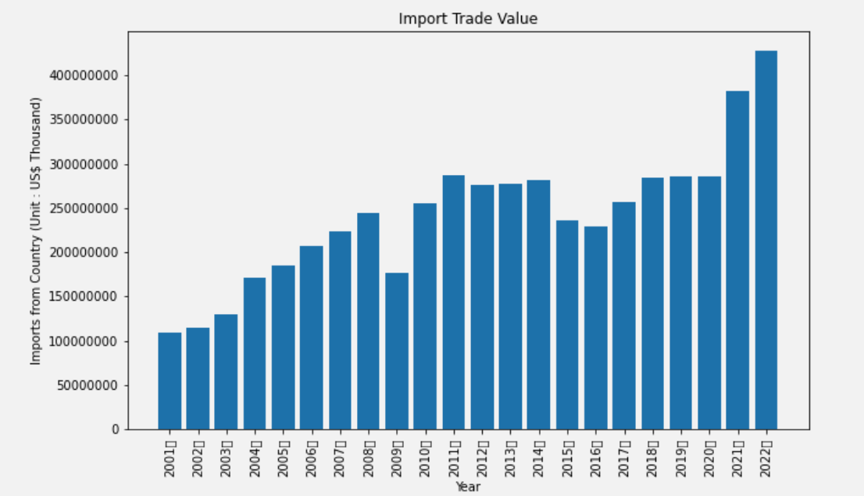
Statistics on Import Trade Value by highest year

Slide 10
Top 10 Importers
Economic Impact
Of Imported goods
Domestic Consumptions
Increasing consumer spending
Competitions
Increasing local goods’ quality
Employment
Providing job opportunities
Vulnerabilities
Proving the dependencies of imported goods

Slide 11
Our Program
https://github.com/Zocke07/Big-Data-Programming-Final/tree/main/ImportByCountry
import csv
import chardet
import matplotlib
import pandas as pd
import matplotlib.pyplot as plt
with open('u2010im.csv', 'rb') as file:
result = chardet.detect(file.read())
data = pd.read_csv('u2010im.csv', encoding=result['encoding'])
data1 = data
country_index = 0
year_index = 273
countries = data.columns
values = data.iloc[year_index]
result = list(zip(countries, values))
for item in result:
for i in item:
if '洲' in str(i):
result.remove(item)
sorted_list = sorted(result[2:], key=lambda x: x[1], reverse=True)
topCountries = []
theValues = []
for n in range(10):
topCountries.append(sorted_list[n][0])
theValues.append(sorted_list[n][1])
fig, ax = plt.subplots(figsize=(10, 6))
plt.title("Import Trade Value")
plt.xlabel("Countries")
plt.ylabel("Imports from Country (Unit : US$ Thousand)")
ax.set_xticklabels(topCountries)
ax.ticklabel_format(style='plain', axis='y')
plt.plot(topCountries, theValues)
plt.show()

Slide 12
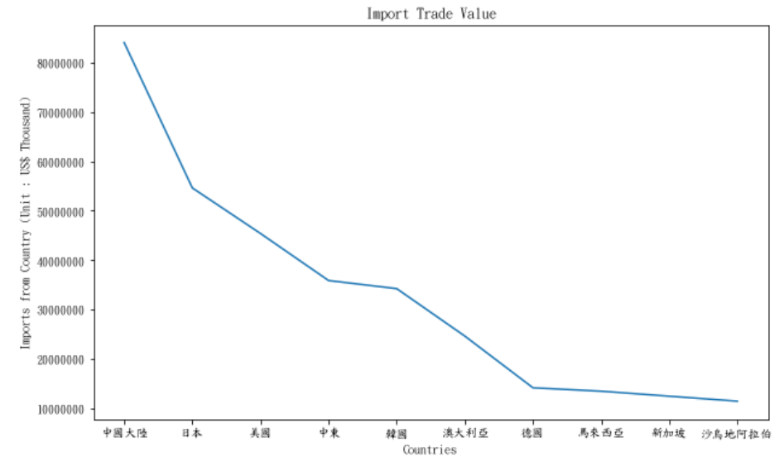
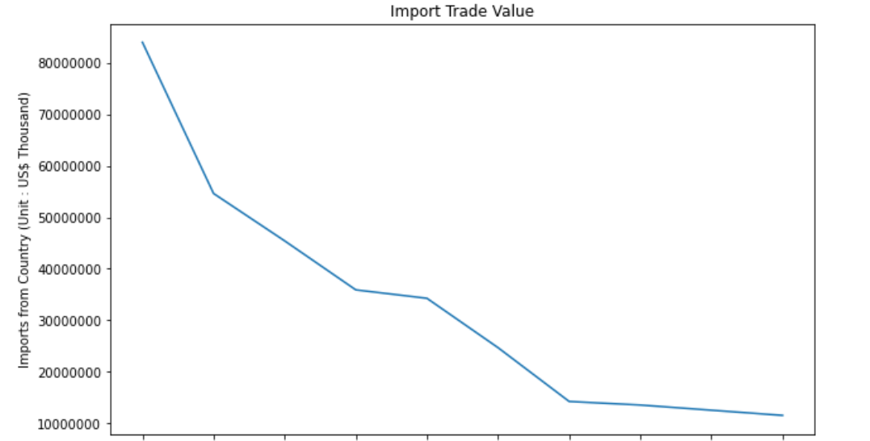
Statistics

Slide 13
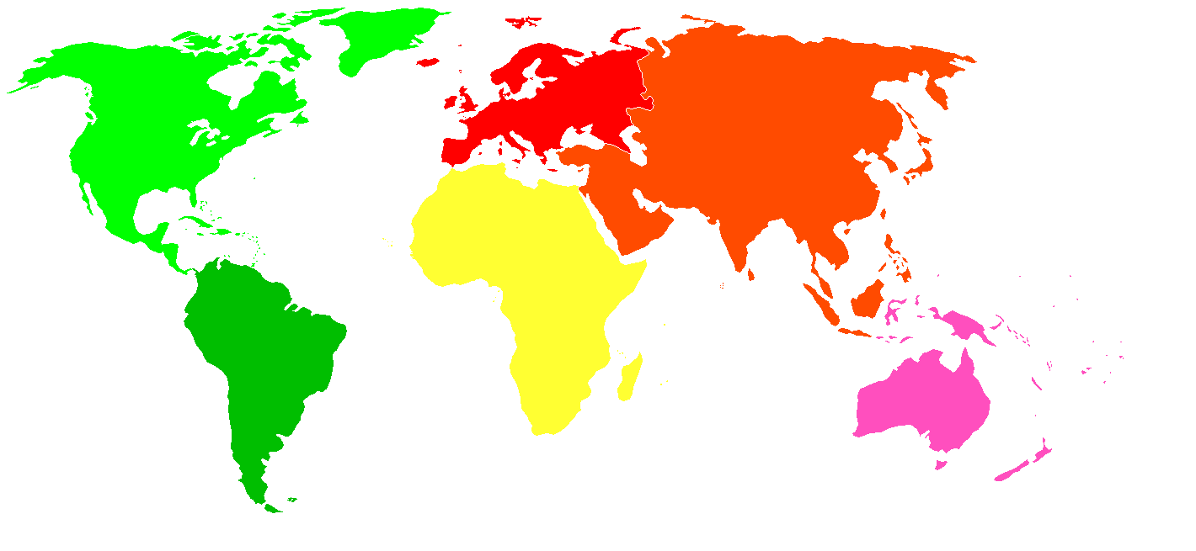
Continent Based Import Values

Slide 14
Our Program
https://github.com/Zocke07/Big-Data-Programming-Final
import chardet
import pandas as pd
import matplotlib.pyplot as plt
import requests
from bs4 import BeautifulSoup
def getNum(continent, country_lst):
num = 0
for i in country_lst:
for j in continent:
if i==j:
num+=1
break
return num
def getTitle(data):
title=[]
headers = data.columns
for header in headers:
title.append(header)
return title
def findCountry(url,num):
# Send a GET request to the Wikipedia page
response = requests.get(url)
# Create a BeautifulSoup object and specify the parser
soup = BeautifulSoup(response.text, "html.parser")
# Find the table containing the data
table = soup.find("table", class_="wikitable sortable")
# Extract the country name column
country = []
for row in table.find_all("tr"):
columns = row.find_all("td")
if len(columns) > num:
name_column=columns[num].text.strip()
temp = 0
for i in name_column:
if (i =='[') or (i == '（') or (i=='(') or (i =='、'):
country.append(name_column.split(i)[0])
break
if temp == len(name_column)-1:
country.append(name_column)
temp += 1
return country
Africa = findCountry("https://zh.wikipedia.org/zh-tw/%E9%9D%9E%E6%B4%B2%E5%9B%BD%E5%AE%B6%E5%92%8C%E5%9C%B0%E5%8C%BA%E5%88%97%E8%A1%A8",0)
Asia = findCountry("https://zh.wikipedia.org/zh-tw/%E4%BA%9A%E6%B4%B2%E5%9B%BD%E5%AE%B6%E5%92%8C%E5%9C%B0%E5%8C%BA%E5%88%97%E8%A1%A8",1)
Europe = findCountry("https://zh.wikipedia.org/zh-tw/%E6%AD%90%E6%B4%B2%E5%9C%8B%E5%AE%B6%E5%92%8C%E5%9C%B0%E5%8D%80%E5%88%97%E8%A1%A8",1)
N_America = findCountry("https://zh.wikipedia.org/zh-tw/%E5%8C%97%E7%BE%8E%E6%B4%B2%E5%9B%BD%E5%AE%B6%E5%92%8C%E5%9C%B0%E5%8C%BA%E5%88%97%E8%A1%A8",1)
S_America = findCountry("https://zh.wikipedia.org/zh-tw/%E5%8D%97%E7%BE%8E%E6%B4%B2%E5%9B%BD%E5%AE%B6%E5%92%8C%E5%9C%B0%E5%8C%BA%E5%88%97%E8%A1%A8",1)
Australia = findCountry("https://zh.wikipedia.org/zh-tw/%E5%A4%A7%E6%B4%8B%E6%B4%B2%E5%9B%BD%E5%AE%B6%E5%92%8C%E5%9C%B0%E5%8C%BA%E5%88%97%E8%A1%A8",1)
Antarctica = findCountry("https://zh.wikipedia.org/zh-tw/%E5%8D%97%E6%9E%81%E6%B4%B2",0)
# Detect the encoding of the file
with open('u2010im.csv', 'rb') as file:
result = chardet.detect(file.read())
# Read the file with the detected encoding
data = pd.read_csv('u2010im.csv', encoding=result['encoding'])
title = getTitle(data)
country_lst = title[2:]
continent_lst_str = ['Africa','Asia','Europe','North America','South America','Australia','Antarctica']
continent_lst = [Africa,Asia,Europe,N_America,S_America,Australia,Antarctica]
num = []
for continent in continent_lst:
num.append(getNum(continent,country_lst))
explode = [0,0,0,0.2,0.2,0.2,0.2]
listm = num
listx = continent_lst_str
plt.title('Import Rate Based on Continent', fontsize=16)
plt.pie(listm, labels = listx, autopct='%2.2f%%',explode=explode)

Slide 15
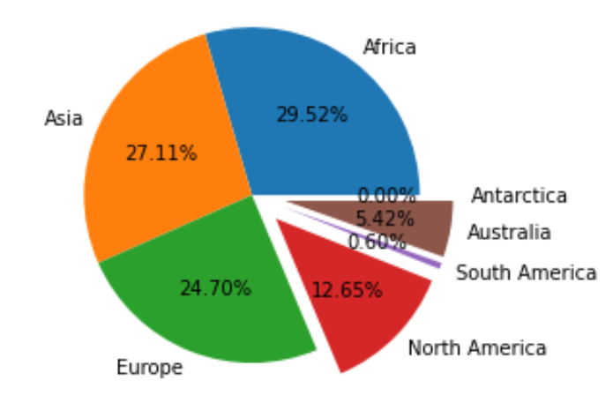
Import Based on Continent

Slide 16
Conclusion
It is evident that import trade plays a crucial role in various aspects of Taiwan's economy, contributing significantly to domestic consumption, industrial production, technological advancements, and fostering innovation.

Slide 17
Work Load
徐釧龍
黃家輝
黃程義
Presentation
Programming
Programming

Slide 18
Thanks for Listening!

